Slide 1
Using Anchor Points to Define and Transfer Spatial Regions Based on Context
Matt Klenk
PARC
Nick Hawes
University of Birmingham
Kate Lockwood
California State University – Monterey Bay
Graham Horn
University of Birmingham
John Kelleher
Dublin Institue of Technology

Slide 2
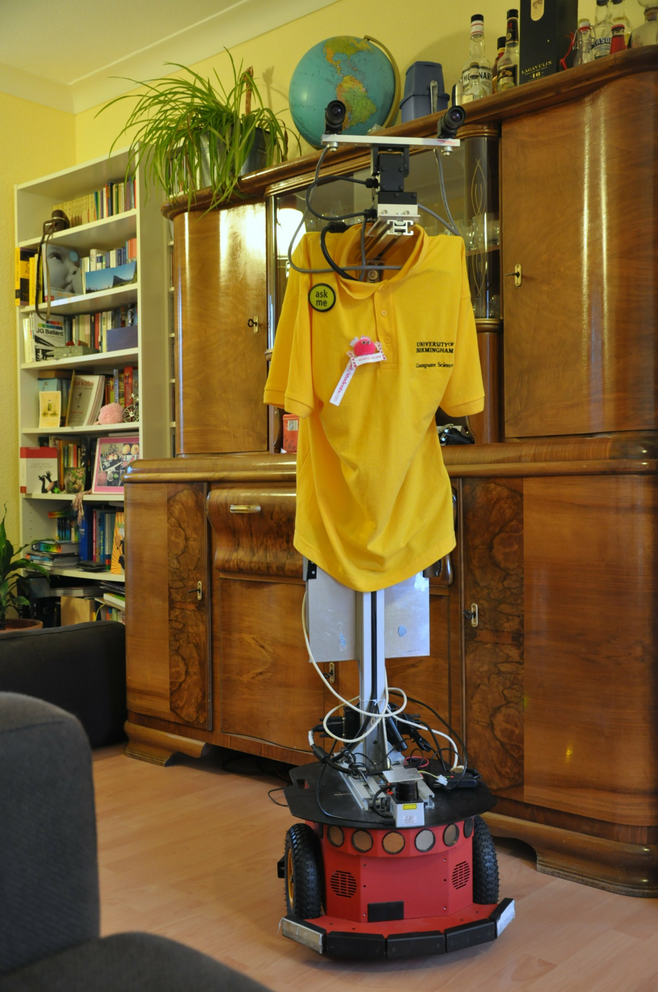

Slide 3
Context Dependent Spatial Regions
Environments are Defined by Context as well as Geometry

Slide 4
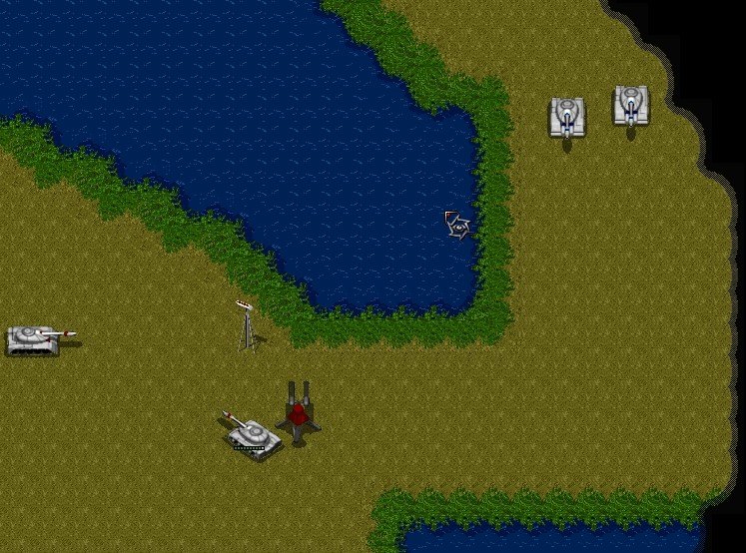
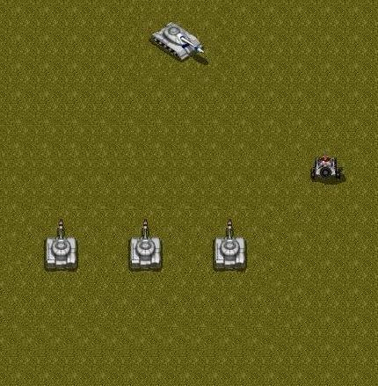

Slide 5


Slide 6


Slide 7


Slide 8


Slide 9
Why is this hard?
From Sensor to Semantics
Increasing interest in the Robotics community
(Special Issue, Spring Symposia)
QR is all about making the relevant distinctions to solve problems

Slide 10
